Slide 1

System Programming Shell Programming Lecture # 3
Dr. Muhammad Bilal Qureshi
m.qureshi@centralasian.uz
Central Asian University, Tashkent, Uzbekistan

Slide 2

Shell Programming
Detour into writing shell programs why?
Linux isn’t like systems where command line interface is an afterthought to GUI.
Originally there was no GUI at all, so command line interface had a lot of development, and it has become very powerful feature and now you can do most powerful things easily from shell. Shell is the integral part of Linux.
So objective is to learn its syntax, structures and commands available.
We will investigate useful command line utilities often called from shell, also we will cover fundamentals of regular expressions. At the end we will wind up with how to program a real-life script.

Slide 3
Content of Shell Programming
What a shell is
Basic considerations
The features of syntax: variable, conditions and program control
Lists
Functions
Commands and command execution
Debugging
Grep and regular expressions
Find

Slide 4
Shell Programming
When you’re faced with nightmare of shell script in your system administration
Want to prototype your latest big idea
Want to speed up some repetitive task

Slide 5
Why Program with Shell
In Unix which is the parent OS of Linux and the origin of many of the ideas a variety of different shell programs are available. The most common on commercial version of Unix is probably the Korn Shell, but there are many others.
So why we use shell to program ? Well, the shell leads a double life. Although it has superficial similarities to windows command prompt, it much more powerful, capable of running reasonably complex programs.
Not only execute commands and call Linux utilities but you can also write them.
The shell uses interpreted language which generally makes debugging easier, because you can execute single line and there is no recompile time, however this can make shell unsuitable for time critical or processor intensive tasks.

Slide 6
Why Program with Shell (Cont..)
One reason to use shell for programming is that you can program the shell quickly and simply. Also, shell is always available even on most basic Linux installation.
Shell is also ideal for many small utilities that perform some relatively simple task where efficiency is less important than easy configuration, maintenance, and portability.
You can use shell to organize process control, so that commands runs in a predetermined sequence dependent on the successful completion of each stage.

Slide 7
A bit of Philosophy
Here we come to a bit of Unix and of course Linux, Unix is built on and depends on a high level of code reuse.
You build a small and simple utility and people use it as one link in a string of others to form a command.
$ ls -al | more
The command uses the ls and more utilities and pipes the output of the file listing to a screen at a time display. Each utility is one more building block.
You can often use many small scripts together to create a large and complex suites of programs. E.g. for printing a copy of bash manual.
$ man bash | col -b | lpr
Furthermore, because of Linux's automatic file type handling, the users of these utilities usually don’t need to know what language the utilities are written in.

Slide 8
What is Shell?
A shell is a program that acts as the interface between you and Linux system, allowing you to enter commands for the operating system to execute.
Input & output can be redirected using < and >, data piped between simultaneously executing programs using |, and output from a subprocess grabbed by using $(…). On Linux its quite feasible to have multiple shells installed, with different users able to pick the one they prefer.
Since Linux is so modular you can slot in one of the many different shells in use, although most of them are derived form the original Bourne shell.
On the Linux, the standard shell that is always installed as /bin/sh is called bash (the GNU Bourne-Again Shell) from the GNU suite of tools. Its portable (POSIX).
/bin/sh default shell is a link to the program /bin/bash
$ /bin/sh --version

Slide 9
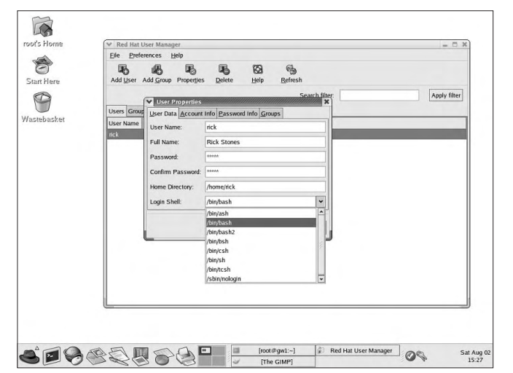
RedHat User Manager

Slide 10
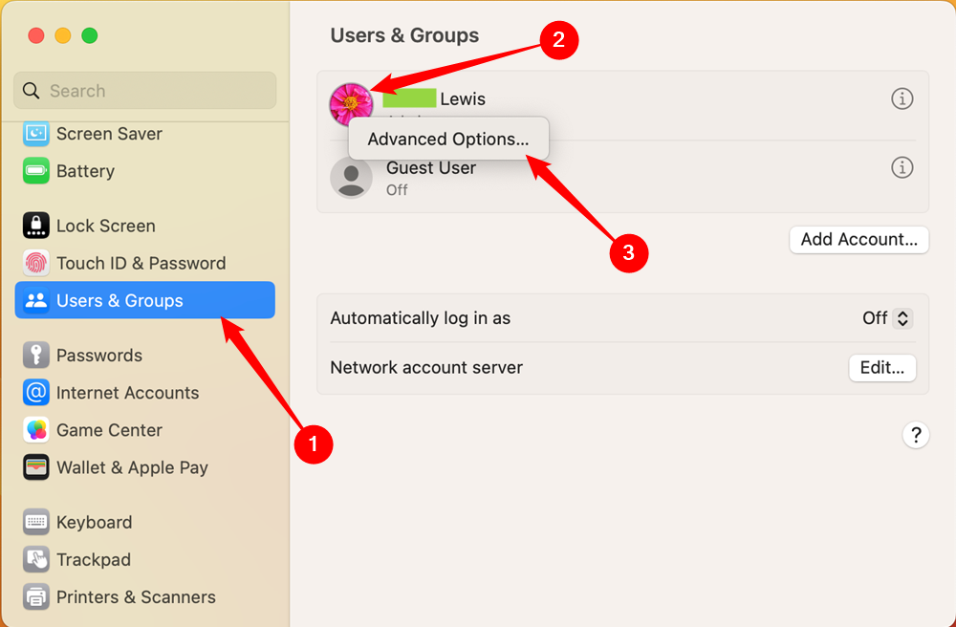
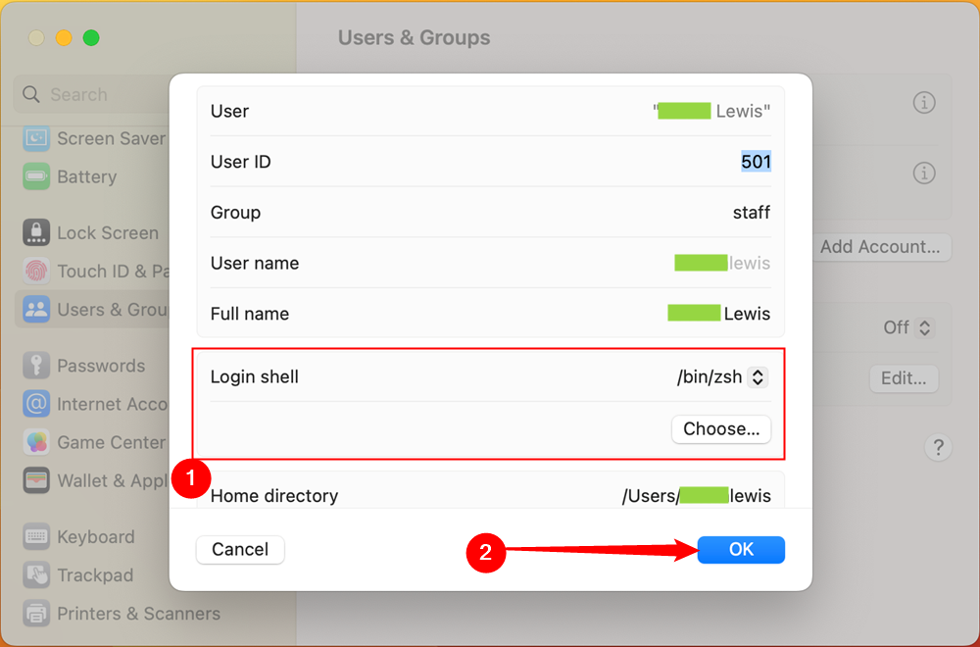
IOS User Manager
chsh –s /bin/sh (change from zsh to bash)
cat /etc/shells (list of acceptable shells)
bash –version
zsh --version

Slide 11
Pipes
We can connect processes using the pipe | operator. In Linux unlike MS-DOS, processes connected by pipe can run simultaneously and are automatically rescheduled as data flows between them. E.g. sort the output from ps.
$ ps > psout.txt
$ sort psout.txt >pssort.out
A much more elegant solution is to connect the processes with a pipe like this,
$ ps | sort >pssort.out
Since we probably want to see the output paginated on the screen, we could connect a third process, more, all in same command.
$ ps | sort | more
There practically no limit on permissible number of connected processes. E.g. seeing process names running excluding shell.
$ ps –xo comm | sort | uniq | grep – v sh | more

Slide 12
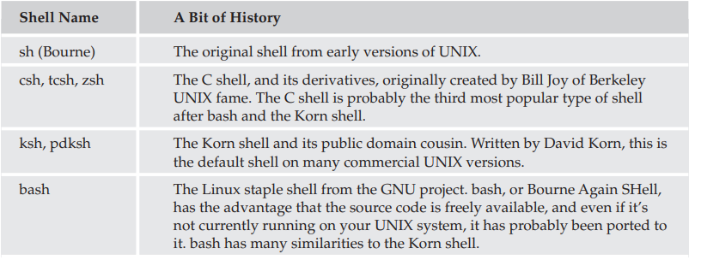
Other Shells

Slide 13
Basic Considerations (Redirection)
Pipes and Redirection (for input and output of Linux program redirection)
Redirecting output:
$ ls -l > lsoutput.txt
File descriptor 0 is the standard input to a program, file descriptor 1 is the standard output, and file descriptor 2 is the standard error output. You can redirect each of these independently.
To append to the file, we use the >> operator. For example,
$ ps >> lsoutput.txt

Slide 14
Redirecting Input
Rather like redirecting output, we can also redirect input. E.g.
$ more < killout.txt
Linux more command is quite happy to accept filenames as parameters, unlike windows line equivalent.

Slide 15
Redirecting Output
To redirect the standard error output, we preface the > operator with the number of the file descriptor we wish to redirect. Since the standard error is on file descriptor 2, we use the 2> operator. This is often useful to discard error information and prevent it from appearing on the screen.
Suppose we want to use the kill command to kill a process from a script.
The following command, will put the output and error information into separate files.
$ kill -HUP 1234 >killout.txt 2>killerr.txt
If you prefer to capture both sets of output into a single file, you can use the >& operator to combine the two outputs. So
$ kill -1 1234 >killouterr.txt 2>&1
$ kill -1 1234 >/dev/null 2>&1

Slide 16
Pipes (Cont..)
If you have a string of commands, the output file is created or written to immediately as the set of commands is created, so never use the same filename twice in a string of commands. If you try to do something like the following:
cat mydata.txt | sort | uniq | > mydata.txt
you will end up with an empty file, because you will overwrite the mydata.txt file before you read it.

Slide 17
Shell as a Programming Language
Now that we’ve seen some basic shell operations, it’s time to move on to scripts. There are two ways of writing shell programs. You can type a sequence of commands and allow the shell to execute them interactively, or you can store those commands in a file that you can then invoke as a program.
Interactive Programs
Just typing the shell script on the command line is a quick and easy way of trying out small code fragments and is very useful while you are learning or just testing things out.
Suppose we have large number of C files and we wish to examine the files that contain the string POSIX. Rather than search using the grep command for the string in the files and then list the files individually, we could perform the whole operation in an interactive script like this:

Slide 18
Shell as Programming Language
$ for file in *
>do
>if grep -l POSIX $file
>then
>more $file
>fi
>done
posix This is a file with POSIX in it - treat it well
$
Note how the normal $ shell prompt changes to a > when you type shell commands. You can type away, letting the shell decide when you’re finished, and the script will execute immediately. In this example, the grep command prints the files it finds containing POSIX and then more prints the contents of the file to the screen. Finally, the shell prompt returns.

Slide 19

Thank you

